Slide 1
Exploring Parameters For Detecting Supernovae Using A Single Interferometer
Travis Hansen, Marek Szczepanczyk, Michele Zanolin
Embry-Riddle Aeronautical University

Slide 2
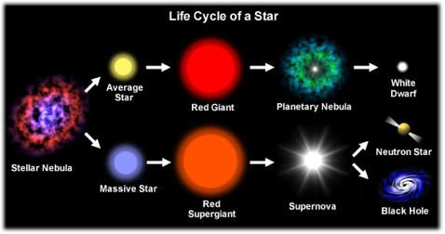

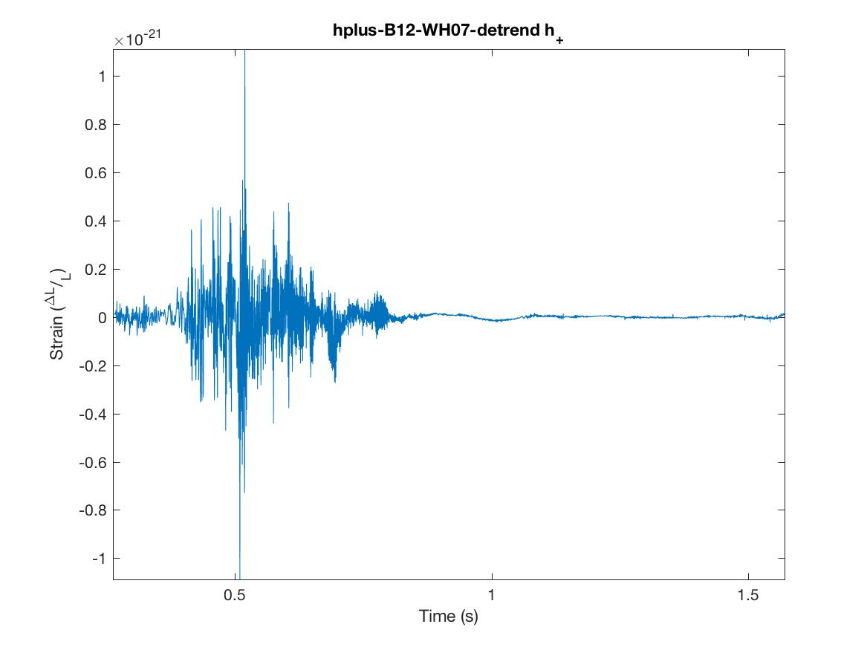
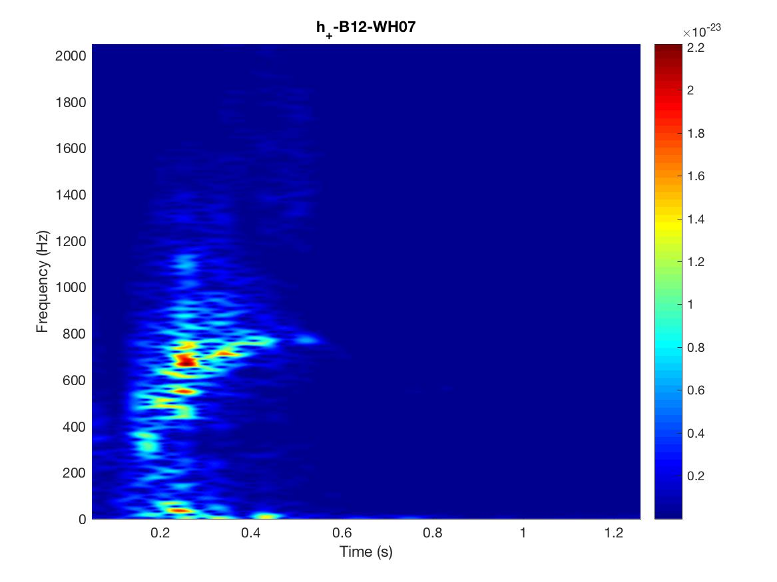
Supernova: An Exploding Star
Understand physics in extreme environments
❖ High densities ❖ High temperatures ❖ Formation of Black Holes
❖ Neutrino emissions ❖ Shock revival mechanism
Galactic SN can happen anytime!

Slide 3
Detecting Gravitational Waves With LIGO

Slide 4
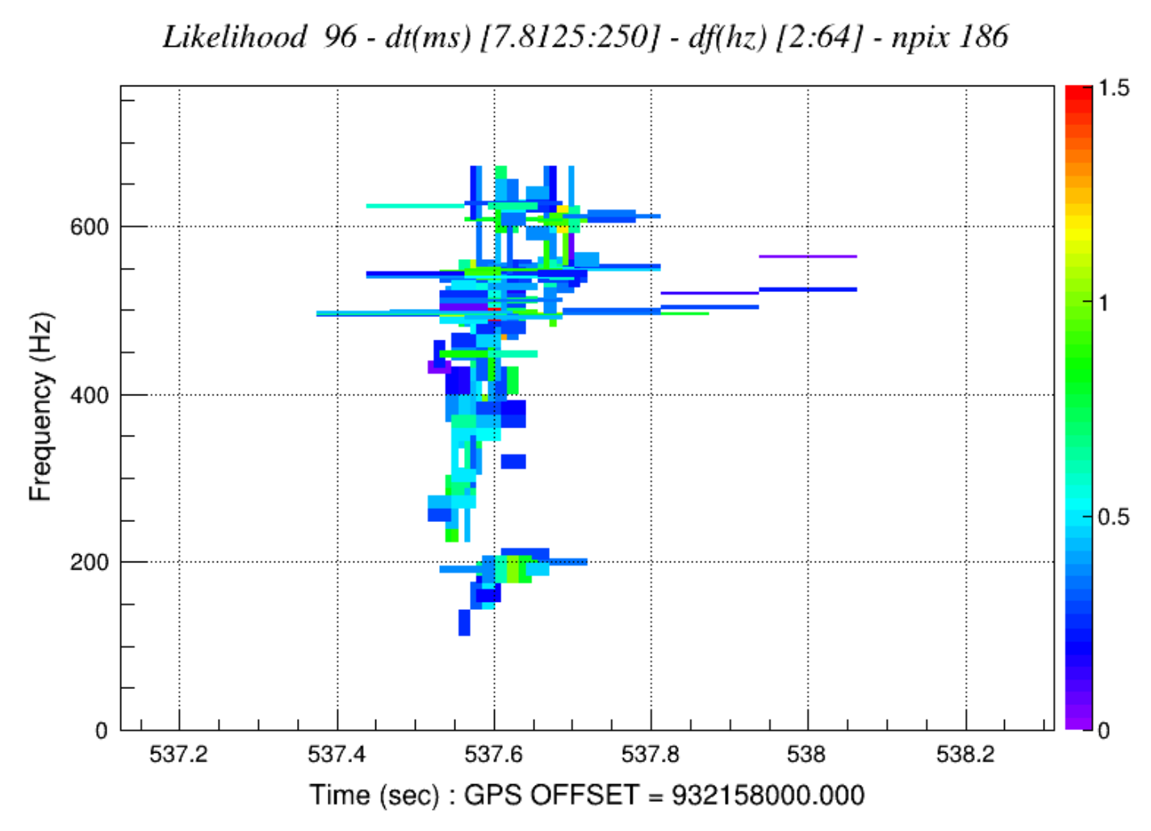
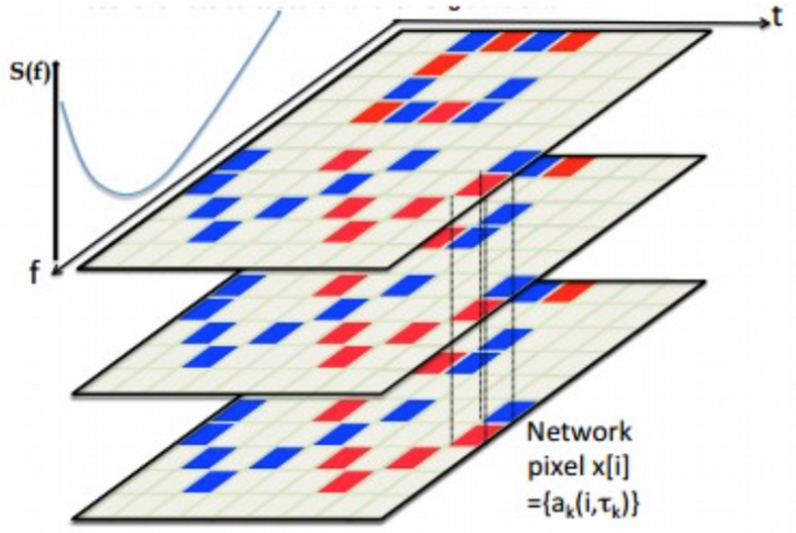
How We Detect These Signals
Standard Method:
Looking for coincidence between two different detectors.
Identifying gravitational wave candidates based on excess energy.

Slide 5
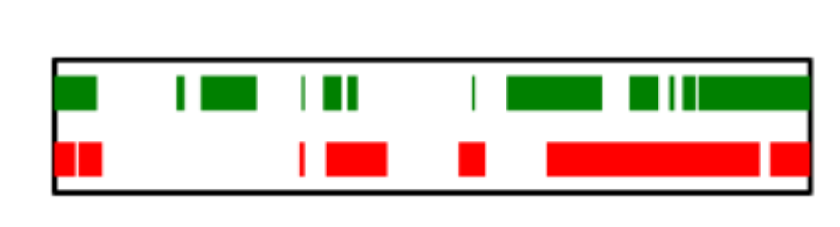
Possible Scenarios of Detector Networks
1
2
3
H1
L1
No detection possible (no data)
Single detector operational (no method developed) *<-Area of my research*
3. Two detectors operational (standard method that allowed for the first gravitational wave detection)

Slide 6
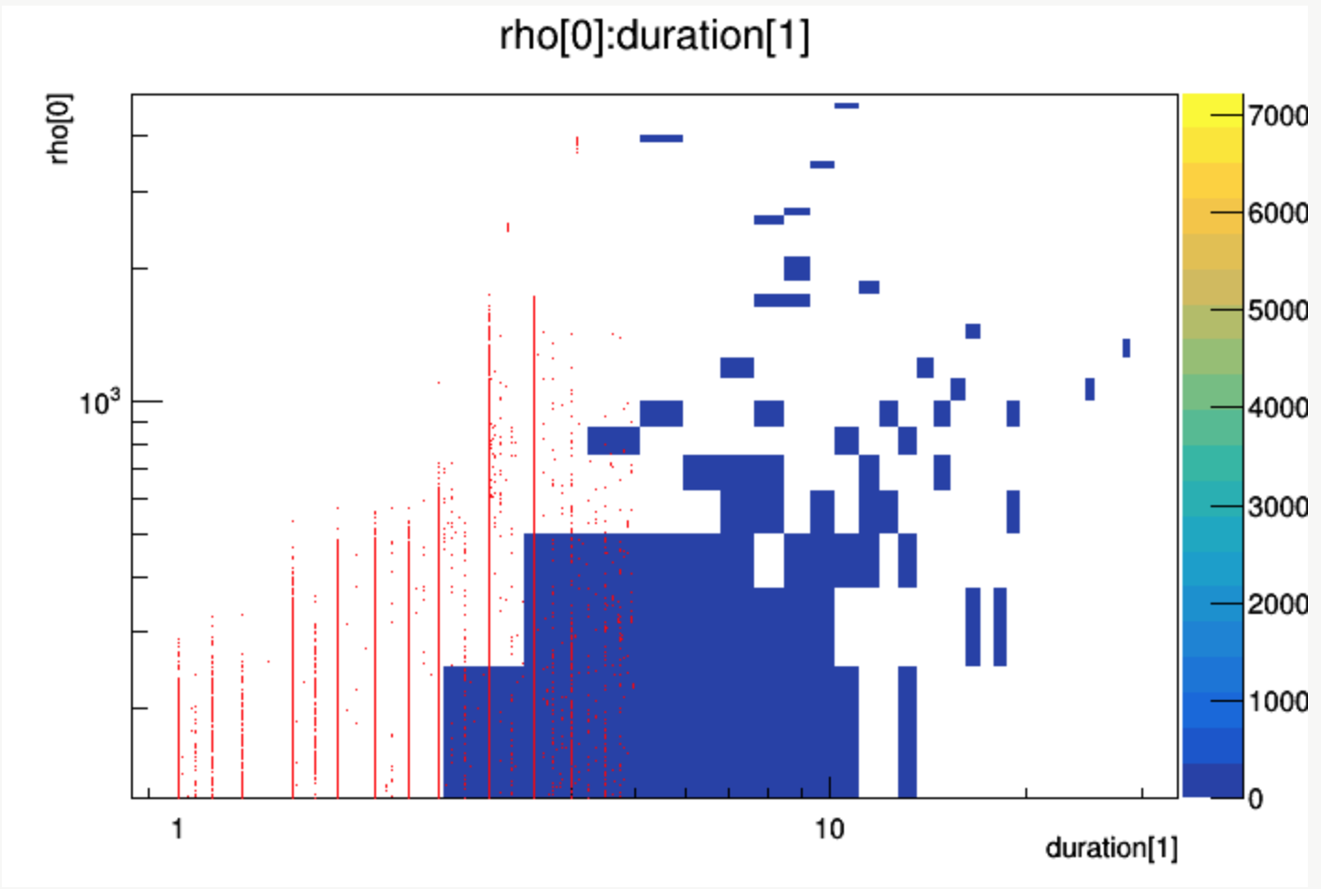
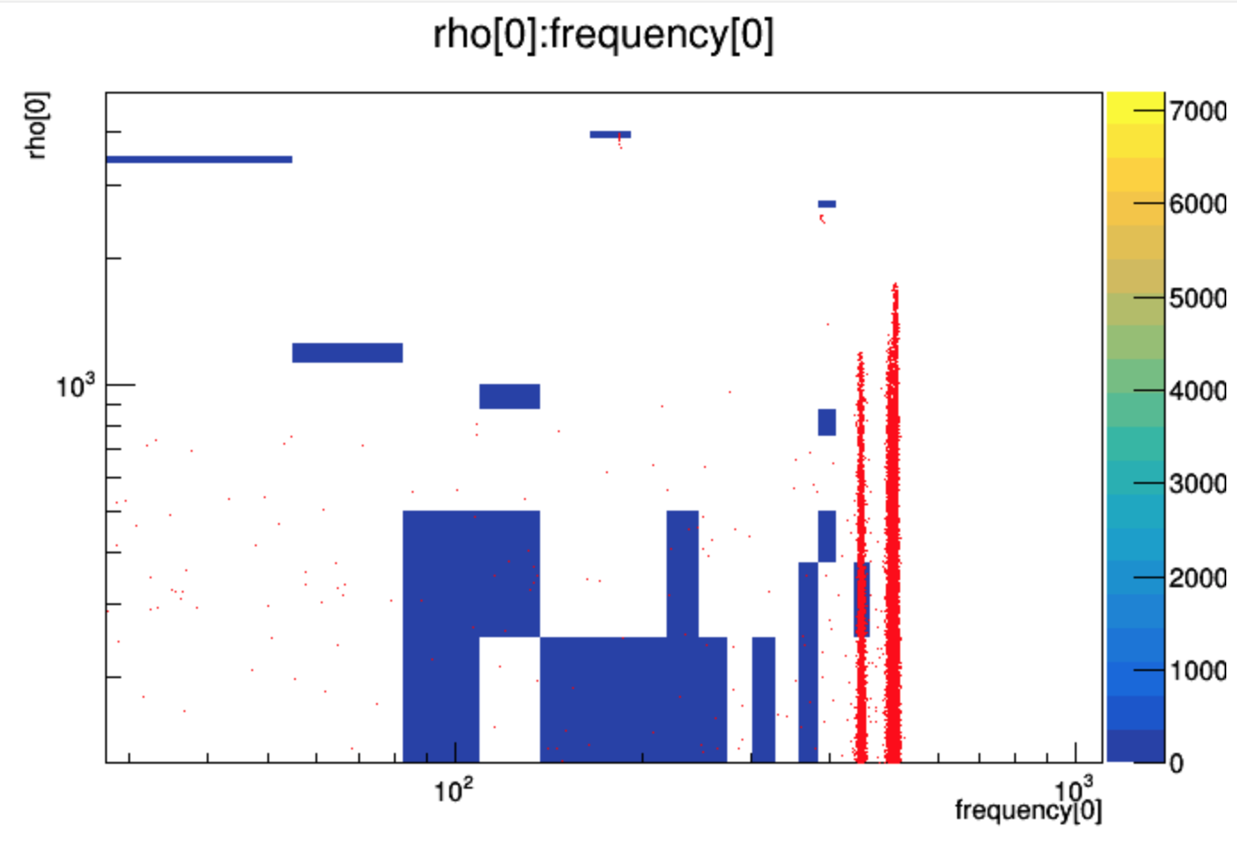
Noise vs. Reconstructed SN Waveforms
Red: Reconstructed waveforms
Blue: Noise
Parameters:
rho[0] - Ranking statistics, effectively SNR
duration[1] - Difference between event stop and start
frequency[0] - Central frequencies of the event computed from the reconstructed waveform

Slide 7
Noise vs. Reconstructed
Based on these plots an efficient way of removing loud background events is to use:
• dominant frequency: frequency[0] > 420 Hz
• duration: duration[1] < 5s

Slide 8
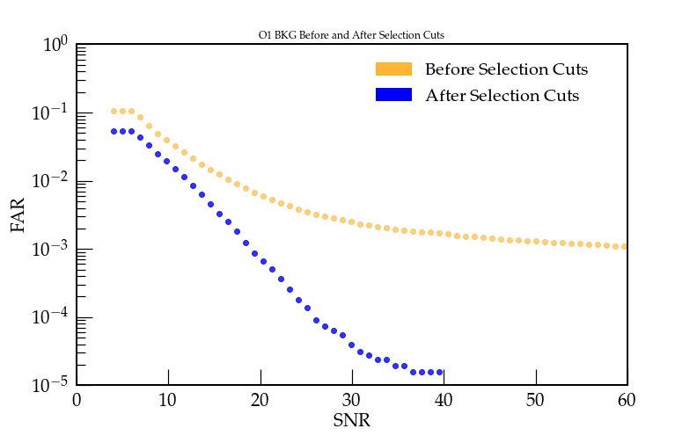
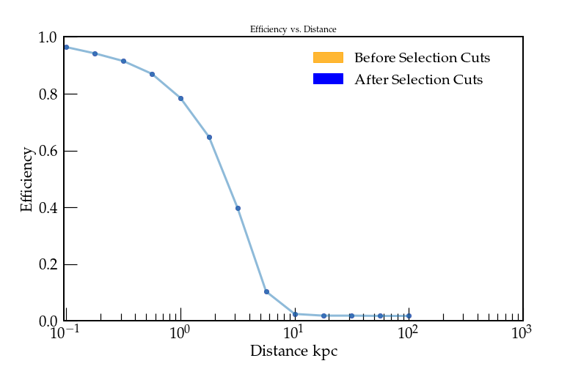
Noise Distribution and Waveform Detectability
Larger Reduction of Noise
After selection cuts we can see that the False Alarm Rate (FAR) was reduced (left plot) while not changing and slightly improving detector efficiency (right plot)

Slide 9
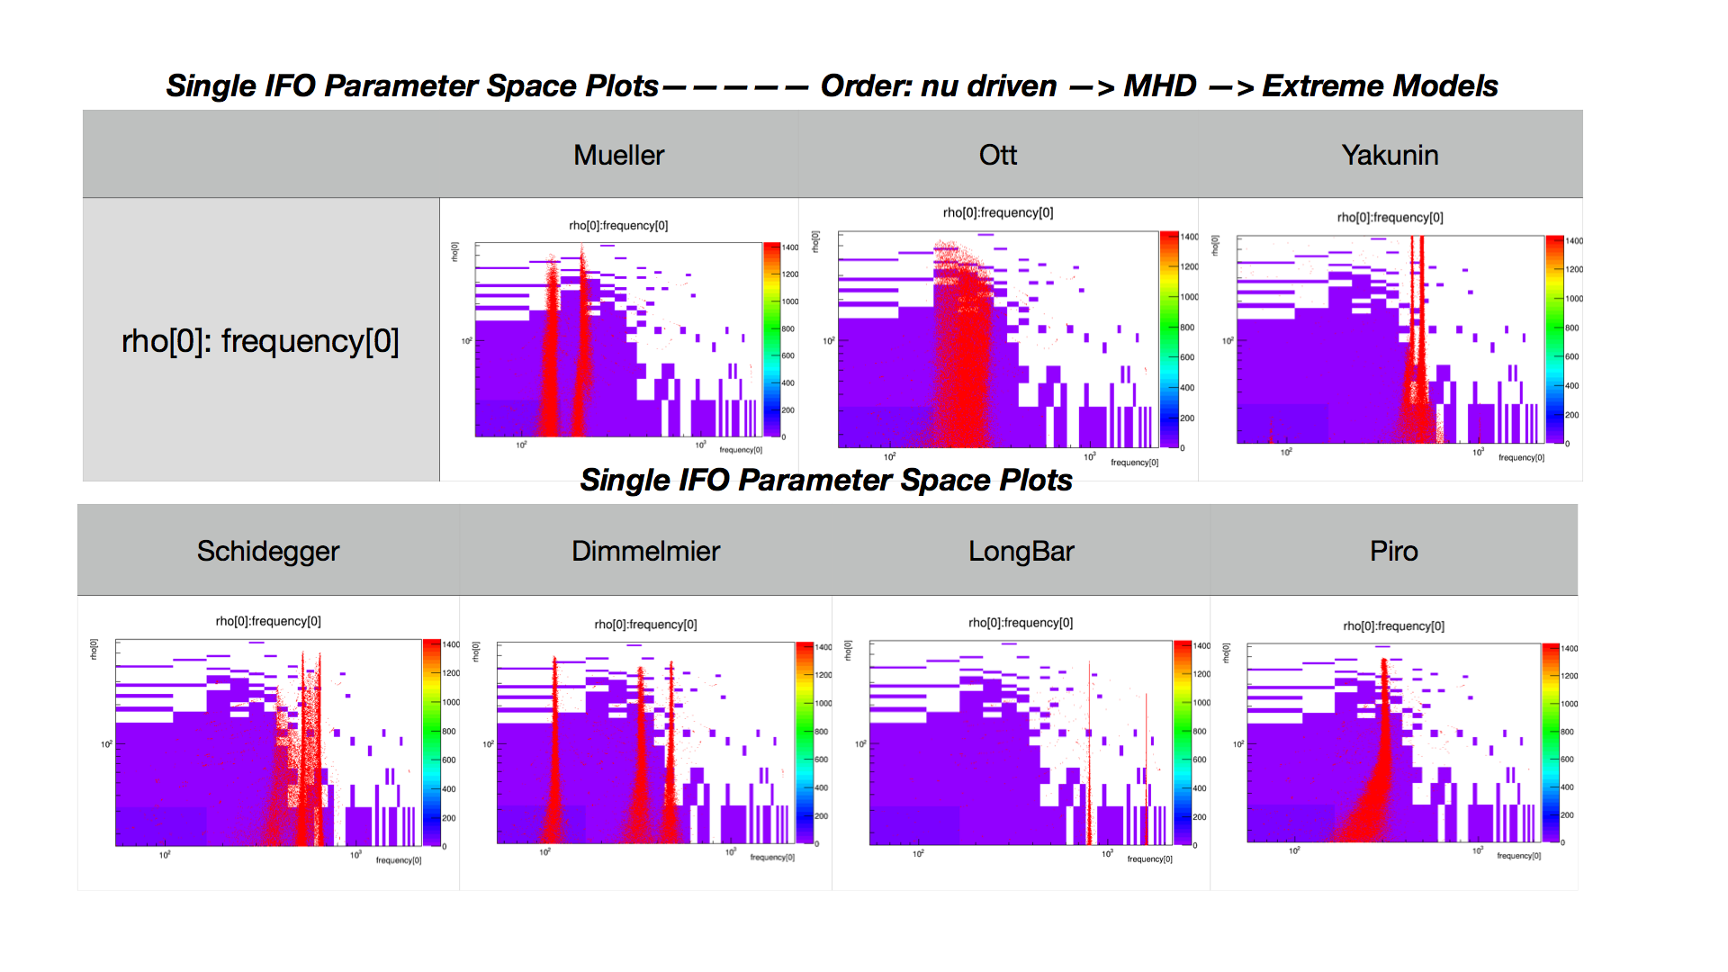
More Waveforms To Look At

Slide 10
Future Direction
Initial studies look promising, but more work to come!
✓ * study rec vs inj SNR, the quality of reconstruction
◦ * study possibility to claim 3 sigma or 5 sigma detection confidence with single IFO
◦ * comparison with two detector network:
◦ * noise trigger distributions
◦ * reconstructed SN waveforms
✓ * minimum detectable SNR
✓ * study SNR distribution for different morphologies
◦ * comparison of noise distributions between L1L1, H1H1 and V1V1
◦ * can we claim the detection with GEO?
◦ * comparison of the non-clean and clean data
◦ * identifying origins of the loudest noise triggers
◦ * study the impact of environmental noise on single IFO triggers
◦ * study why the data quality files do not remove loudest events
◦ * creating a special veto for single IFO
◦ * is there a possibility of tuning single detector to maximize chance of a detection?
◦ * repeat the analysis with the O3 SN set of waveforms (future)

